Slide 1


React Prayer Application
By Noah Funderburgh

Slide 2
Challenges
One challenge I had was executing the delete operation
I was able to figure it out by adding handleDeletePrayer within prayerList.js
I felt as this wasn’t ideal though because I had to import dataSource

Slide 3
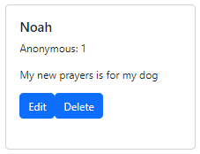
Pending Bugs
There are pending bugs that I have found
There are improvements that I would like to make to the application
I was unable to figure out how to have the users name be anonymous when selected as true

Slide 4
Lessons learned
I learned the importance of using components
Provided both reusability and modularity
Components also make testing easier

Slide 5
Links
Git Repo - https://github.com/nfunderburgh/CST-391Milestone.git

